Slide 1
The
art of
presentation

Bharat
mane

Slide 2
Tell a story of my first public speaking
And that humiliation I decided Never again

Slide 3
If…
what
Bharat
mane
Notes:
https://www.quora.com/How-many-presentations-are-given-each-day
https://www.tedtakahashi.com/2013/04/05/ten-interesting-facts-about-powerpoint
https://www.thinkoutsidetheslide.com/are-we-wasting-250-million-per-day-due-to-bad-powerpoint//

Slide 4
I tell you there are more than
30 million presentations
made each day
Bharat
mane
Notes:
Ian Parker in The New Yorkermagazine states that according to Microsoft estimates, there are more than 30 million PowerPoint presentations made each day.

Slide 5

If we assume 4 people per presentation,
a half-hour presentation on average
and the wasted time due to
a poor presentation is one-quarter of
the presentation time
(30 X 4 X 7.5) / 60 = 30 million person hours per day
Bharat
mane
Notes:
https://www.quora.com/How-many-presentations-are-given-each-day
https://www.tedtakahashi.com/2013/04/05/ten-interesting-facts-about-powerpoint
https://www.thinkoutsidetheslide.com/are-we-wasting-250-million-per-day-due-to-bad-powerpoint//

Slide 6

…the cost of that wasted time
$252 millions
Bharat
mane
Notes:
The cost of a poor PowerPoint presentation is staggering. Ian Parker in The New Yorkermagazine states that according to Microsoft estimates, there are more than 30 million PowerPoint presentations made each day. If we assume some relatively conservative meeting parameters of four people per presentation, a half-hour presentation on average and the wasted time due to a poor presentation is one-quarter of the presentation time, we arrive at a waste of 15 million person hours per day. At an average salary of $35,000 per year for those attending the meeting, the cost of that wasted time is a staggering $252 million and change each day.soft estimates, there are more than 30 million PowerPoint presentations made each day.

Slide 7
If…
what
Bharat
mane
Notes:
https://www.quora.com/How-many-presentations-are-given-each-day
https://www.tedtakahashi.com/2013/04/05/ten-interesting-facts-about-powerpoint
https://www.thinkoutsidetheslide.com/are-we-wasting-250-million-per-day-due-to-bad-powerpoint//

Slide 8
…I tell you, you get paid
10% less…
Bharat
mane
Notes:
Public speaking fear (Glossophobia) is a form of social anxiety disorder (SAD). There is a lot of misinformation out there about this fear and the number of people suffering from it.
Don’t freak out!
https://magneticspeaking.com/7-unbelievable-fear-of-public-speaking-statistics/

Slide 9
Getting into a leadership position
15% less chances
Bharat
https://magneticspeaking.com/7-unbelievable-fear-of-public-speaking-statistics/
mane
Notes:
Public speaking fear (Glossophobia) is a form of social anxiety disorder (SAD). There is a lot of misinformation out there about this fear and the number of people suffering from it.
Don’t freak out!
https://magneticspeaking.com/7-unbelievable-fear-of-public-speaking-statistics/

Slide 10

stance
beginning
& end
story
telling
body
language
rehearse
Bharat
mane

Slide 11
What is more important
Bharat
mane

Slide 12
The joke or the way
it was delivered?
Bharat
mane

Slide 13

Primacy
Recency
effect
effect
Probability of remembering
Beginning
End
Bharat
mane

Slide 14
Less is more
Bharat
mane
Notes:
William Shakespeare said, “Sometimes, less is more”

Slide 15
Simplicity is the
ultimate sophistication
Bharat
mane

Slide 16
You earn your trophies at practice
Bharat
mane
Notes:
William Shakespeare said, “Sometimes, less is more”

Slide 17
You just pick them up
at competitions
Bharat
mane

Slide 18
People hear statistics…
Bharat
mane
Notes:
William Shakespeare said, “Sometimes, less is more”

Slide 19
But they
feel stories
Bharat
mane

Slide 20
Great stories happen to those…
Bharat
mane
Notes:
William Shakespeare said, “Sometimes, less is more”

Slide 21
Who can
tell them
Bharat
mane

Slide 22
You can have anything
Bharat
mane
Notes:
William Shakespeare said, “Sometimes, less is more”

Slide 23
If you dress
for it
Bharat
mane
Notes:
Edith Head was an American costume designer who won a record eight Academy Awards for Best Costume Design,

Slide 24
The most powerful person
in the room…
Bharat
mane
Notes:
There would be adrline rush
Stand still

Slide 25
…has the most relaxed
breathing pattern
Bharat
mane
Notes:
Edith Head was an American costume designer who won a record eight Academy Awards for Best Costume Design,

Slide 26
Chin up princess
Bharat
mane
Notes:
There would be adrline rush
Stand still

Slide 27
or
the crown slips
Bharat
mane
Notes:
Edith Head was an American costume designer who won a record eight Academy Awards for Best Costume Design,
Confidence is like a muscle: The more you use it, the stronger it gets

Slide 28

King of the…
Paul Ekman (psychologists https://www.paulekman.com/)
Bharat
mane
Notes:
Engage the audience, stories would be remembered

Slide 29
Enthusiasm is infectious
Bharat
mane
Notes:
Engage the audience, stories would be remembered

Slide 30
“
Responses for a piece of design
YES, NO & …?

Slide 31
Responses for a piece of design are Yes, No, & …?
Bharat
mane
Notes:
There would be adrline rush
Stand still

Slide 32
WOW
Aim for Wow
Bharat
mane
Notes:
Edith Head was an American costume designer who won a record eight Academy Awards for Best Costume Design,
Confidence is like a muscle: The more you use it, the stronger it gets

Slide 33
Excuses
Bharat
mane
Notes:
There would be adrline rush
Stand still

Slide 34
I have got
a bad voice
Bharat
mane
Notes:
Edith Head was an American costume designer who won a record eight Academy Awards for Best Costume Design,
Confidence is like a muscle: The more you use it, the stronger it gets

Slide 35
Have you heard abouta bad saxophone?
Bharat
mane

Slide 36
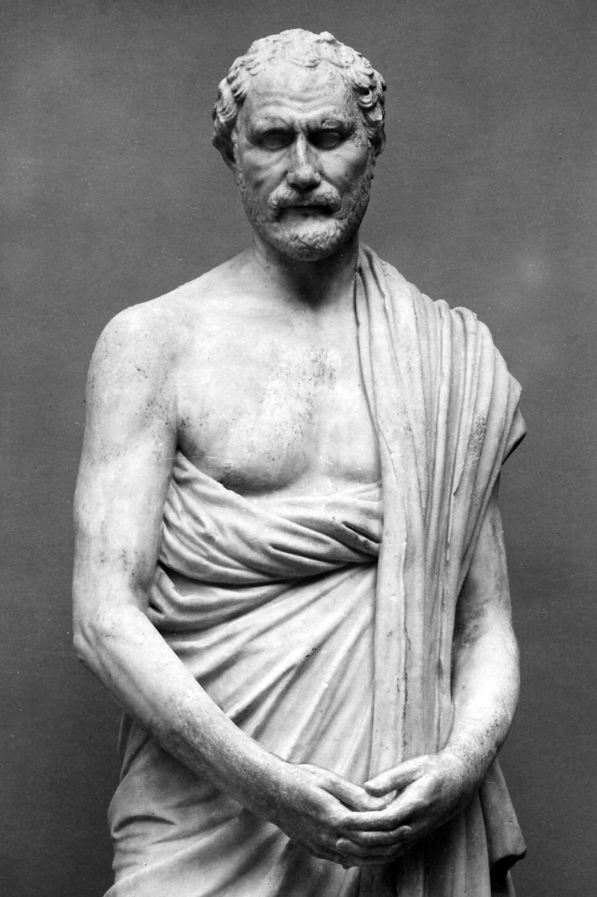
Demosthenes
https://youtu.be/eIho2S0ZahI
Notes:
Demosthenes, (born 384 BCE, Athens [Greece]—died Oct. 12, 322, Calauria, Argolis), Athenian statesman, recognized as the greatest of ancient Greek orators, who roused Athens to oppose Philip of Macedon and, later, his son Alexander the Great. His speeches provide valuable information on the political, social, and economic life of 4th-century Athens.
Demosthenes built an underground study where he exercised his voice, shaving one half of his head so that he could not go out in public.
Plutarch adds that Demosthenes had a speech defect, “an inarticulate and stammering pronunciation” that he overcame by speaking with pebbles in his mouth and by reciting verses when running or out of breath. He also practiced speaking before a large mirror.

Slide 37

Julian Treasure
How to speak so that people want to listen
from 07:51
Notes:
https://youtu.be/eIho2S0ZahI

Slide 38

Communication works for those who work at it
john powell

Slide 39
Make friends with the crew, ask names, remember them
Do a sound check
English is a language and communication is an art that can be learned, that can be developed
Tell the audience the point
Start with a good template
Choose visuals wisely
Notes:
http://eslide.com/visuals-are-key-to-presentation-success/
https://www.forbes.com/sites/markfidelman/2014/08/15/20-world-class-presentation-experts-share-their-top-tips/#71ab6ecc5c40

Slide 40
“
Your life in your pocket

Slide 41
To give a successful presentation they say you need a good opening and a good ending and keep them close together. Research shows audience remember the first and the last few minutes of presentation long after they have forgotten most of what was said in the middle
Aim for Wow

Slide 42
WOW
Aim for Wow

Slide 43
“How can I present … (sound) like a native?”
Aim for Wow

Slide 44
Tell the audience what you are going to tell them.
2. Tell them.
3. Tell the audience what you told them.

Slide 45
Simplicity should also be your buzzword
In iPhone 2007 launch, one heading was “Your life in your pocket”.
A really good copywriting rule of thumb to keep if you are having trouble consolidating the words on your slide is that you should look to cut 20% of your words after the first draft, and then cut them again a second time.

Slide 46
Jobs keynotes presentation is like a musical orchestra, paying attention to even the minutest of details. In his presentation, he doesn’t sell products, he sells dreams and promise of a better world.

Slide 47
Effective communication is way more than being simple
It works both ways, you just don’t have to be a good speaker but a good listener
Listening and Understanding are important pillars of effective communication skills.
Notes:
https://www.yodiz.com/blog/effective-communication-5-surprising-facts-you-should-know/

Slide 48
Presentation go far beyond words. They connect you with people mentally and emotionally

Slide 49
We listen only 100-125 words per minute

Slide 50
while our brain can utilize up to 3000 words per minute during thinking

Slide 51
These communication facts are just going to surprise you
Facial expressions matter way more
Our thinking and listening doesn’t align
Listening and vision also have conflicts
Your employer loves effective communication
Words definitely speak louder
Notes:
1. Facial expressions matter way more
We care very less about our expressions; our focus is words. What if I tell you that more than half of what you said just doesn’t matter because your expressions weren’t aligning with your words.
2. Our thinking and listening doesn’t align
Not just that they don’t get along well but they seriously have some issues. Apparently our hearing is much slower than our brain’s ability to think. We listen only 100-125 words per minute while our brain can utilize up to 3000 words per minute during thinking.
3. Listening and vision also have conflicts
We process images faster than words. We can only listen and store 7 bits of information at a single time. While our vision stores the images seen forever in our long term memory. We are more likely to remember images for a longer time.
4. Your employer loves effective communication
The best employers want someone with exceptional communication skills. Someone who knows about verbal communication and has fair knowledge on how to improve communications skills for benefit of the company. Even your promotions are based on your ability to overcome communication barriers.
5. Words definitely speak louder
Our words have the ability to impact others. The impact sometime is vast enough to spread over decades. Our words can influence people positively and negatively. It might hurt someone more than we can imagine. According to a study emotional distress is felt more deeply. Most of this distress is caused by what we say to each other.

Slide 52
Notes:
https://www.yodiz.com/blog/learning-presentation-skills-from-steve-jobs-speech-and-keynotes/
1. Concise Headings and Theme
Theme meant a lot to Jobs.He always started with a headline which can be easily remembered and is short and comprehensive. The headings were short enough to be posted on twitter. In iPhone 2007 launch, one heading was “Your life in your pocket”. This meant that iPhone has so many features that it almost covers all aspects of your social requirements. But instead of putting up never ending slides. He just put up “Your life in your pocket”.
2. Interesting stories
Jobs always did that. He knew how to interact with audience. He presented himself from audience point of view. He told stories that are commonly experienced by users regarding Apple’s products. Once he said in a presentation “I was sitting in this cafe using iPad and noticed this girl totally checking me out”. His slide consisted of just these few words. While he explained the story himself about Apple’s products getting you girls and absolutely had everyone laughing.
3. His style Was Fewer Words
No matter how long the topic was. Jobs always managed to cover in fewer words.
“Music, calls and internet.” – introducing iPhone
“Thousand songs in your pocket.” – introducing iPod.
“Touch your music.” – introducing iPod touch.
“The world’s thinnest notebook.” – introducing MacBook Air.
He summed up the product in few minimal words and had the audience completely persuaded.
“Music, calls and internet.” – Jobs introducing iPhone
4. Give The Remember-able Statistics
He always had the numbers simplified. In his presentation when he wanted to tell the progress of iTunes, instead of saying that 25 billion songs have been downloaded from iTunes. He said that 15,000 songs are downloaded from iTunes every minute and that’s pretty huge and memorable.
5. Images
He had incredible images in his presentation. There wasn’t too much media. It was just focused on one or two images which were enough and represented the whole point.
6. Fewer Text
The Steve Jobs presentation didn’t had too much text. Every point contained minimum 1 and maximum 4 words.
7. Smiles
His whole presentation was kind of joy because he always continued smiling the whole time. Just have a look at the headshot photo of Steve Jobs.
8. Put on a show
Steve got an envelope from his team during presentation. He showed it to audience and pulled out a sleek Macintosh. The audience were engaged, interested and entertained.

Slide 53
We can only listen and store 7 bits of information at a single time

Slide 54
According to a study emotional distress is felt more deeply

Slide 55
Always be clear and make sure your communication style isn’t impacting anyone negatively.

Slide 56


Slide 58
Art of
presentation

Bharat
mane

Slide 59
What if I tell you…

Slide 60
I am sure now

Slide 61
You get paid
10% more…

Slide 62
अगर भरोसा उपरवाले पर है तो ,
जो लिखा तक़दीर में है वही पाओगे ,
मगर भरोसा अगर खुद पर है तो ,
वो वही लिखेगा जो आप चाहोगे

Slide 63
Bharat
mane

Slide 64

Bharat
mane

Slide 65
https://www.youtube.com/watch?v=Q5WT2vweFRY
The surprising secret to speaking with confidence
How to open and close presentations? - Presentation lesson from Mark Powell
08 Simple tips to develop great Presentation Skills - Public speaking tips | Body language
How to develop your Communication Skills by International Keynote Speaker Simerjeet Singh

